Slide 1


HOUSING PRICE ANALYSIS The Factors That Drive Home Values
Ames, Iowa
Presented by: Nenden Novianty

Slide 2

OBJECTIVES
Look up the factors that drive up home prices
Giving valuable information for investors on allocating dollars earmarked for investments into mortgage back securities
Finding the factors that need to be considered by investors before investing in real estate
What feature attracts the buyers most to buy a house?

Slide 3
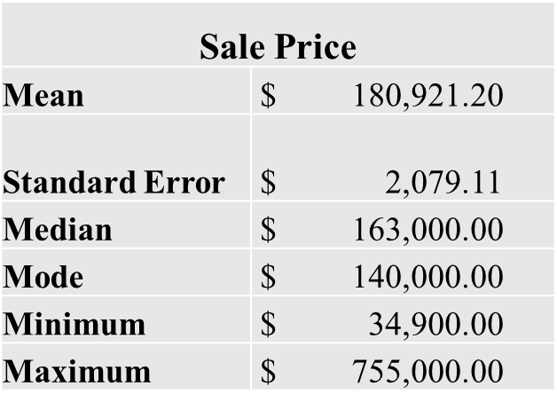
ABOUT THE DATA
The data set was a sample of 1,460 houses in Ames, Iowa that were sold between the year 2006-2010
Data set source originally comes from Kaggle, the world’s largest data science community
These records have 82 features recording data regarding various aspects of a house, with an approximately even distribution between categorical and numerical data.
Descriptive statistics from dataset

Slide 4
Goals
What factors affect home prices which lead to great investment?
Does considering either of the following variables will have a significant impact on the home prices?
Overall Quality Scores
Garage Cars

Slide 5

TOP DRIVING FACTORS
Quality, Neighborhood, Age of the home, Square Footage, and Additional Features are the factors that have a big impact on prices.
I hypothesized some of the biggest driving factors would be determined by these variables:
Overall Quality Scores
Garage Cars amount
Which will be proved by hypotheses

Slide 6

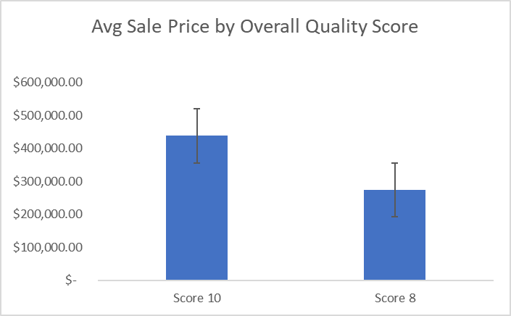
Hypotheses
OVERALL QUALITY
RESULT: STATISTICALLY SIGNIFICANT DIFFERENCE BETWEEN HOUSE WITH OVERALL QUALITY SCORE OF 10 AND HOUSE WITH OVERALL QUALITY SCORE OF 8 HOME SALES PRICE
T-tests H₀ : p = 0, H₁ : P < .05
Houses with quality score 10 vs 8: P = 0.0004,
P < .05
Reject the null = TRUE
With a 95% confidence interval, the average sales price for houses with overall quality score of 10 is between $84 K and $243 K higher compared to houses with overall quality score of 8

Slide 7
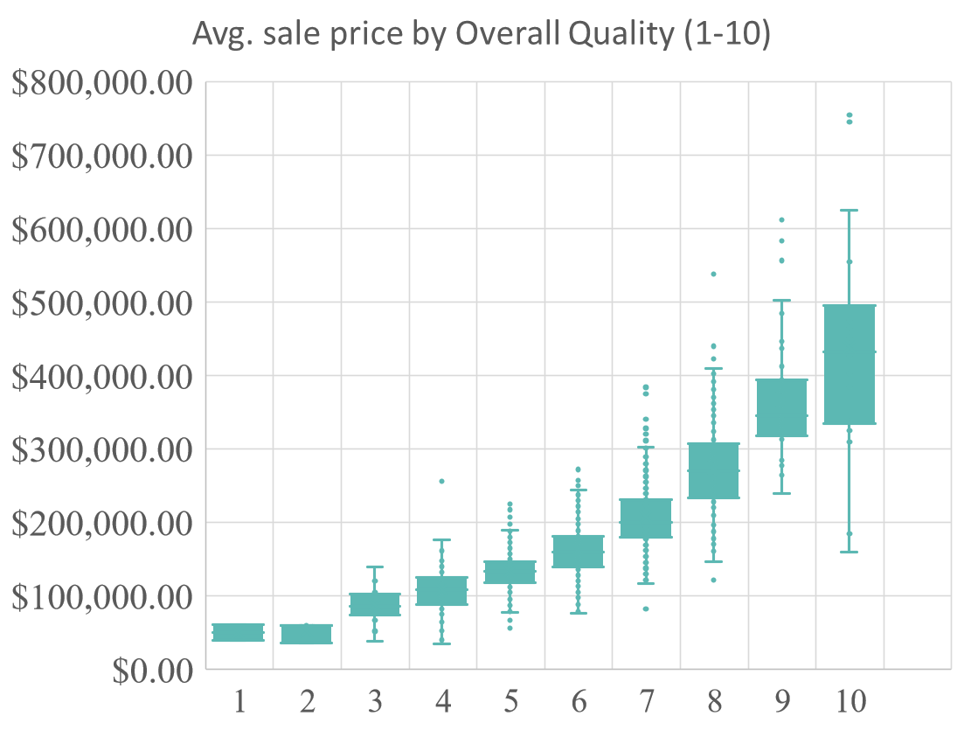
Hypotheses

Slide 8

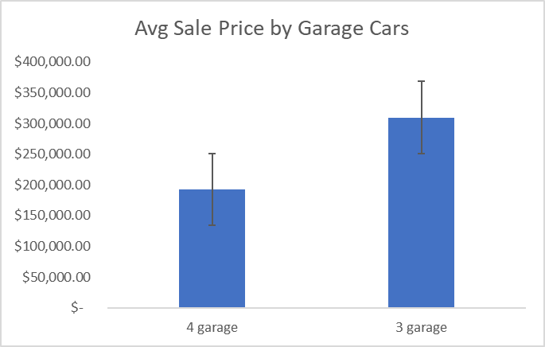
Hypotheses
GARAGE CARS
RESULT: STATISTICALLY SIGNIFICANT DIFFERENCE BETWEEN HOUSE WITH 3 CAR GARAGE AND HOUSE WITH 4 CAR GARAGE HOME SALES PRICE
T-tests
H0: p = 0, H1: P < .05
Houses with 3 car garage VS 4 car garage
P = 0.005
P < .05 at .005
Reject the null = TRUE
With a 95% confidence interval, the total
sales price for houses with 3 car garage is
between $113 K and $120 K higher
compared to houses with 4 car garage

Slide 9

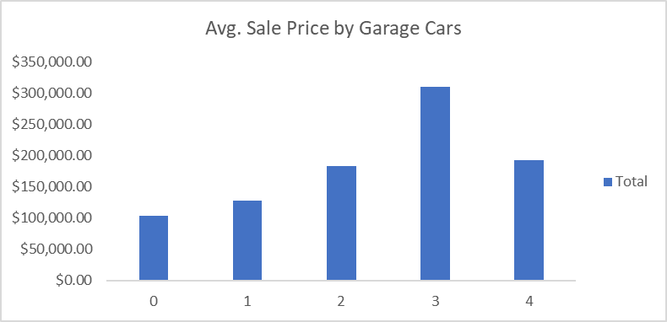
Hypotheses

Slide 10
Process
This project was done in Excel by utilizing pivot tables and the Data Analysis ToolPak to manipulate the data.
Ran Student’s t-tests on resulting variables to check my work
T-tests: Picked out a handful of categorical variables based on research and conducted student t-tests to test the significance of their effects on home prices.
Created chart visualization

Slide 11
Result
From the method and hypotheses, the 2 factors which are house overall quality and garage cars variable, both of them proven to be the factors that drive home prices.

Slide 12
RECOMMENDATION
Invest in houses with the following features:
Overall Quality Score of 10
House with 3 Garage Cars

